Slide 1
Data Mining Presentation
By: Mohammad A., Mathew B., John C.
Infinity Team || Team 1

Slide 2
AGENDA
Introduction
Our Project
Data Preprocessing
Deep Learning Models
CNN (Convolutional Neural Network)
RNN (Recurrent Neural Network)
LSTM (Long Short-Term Memory Network)
Conclusion

Slide 3
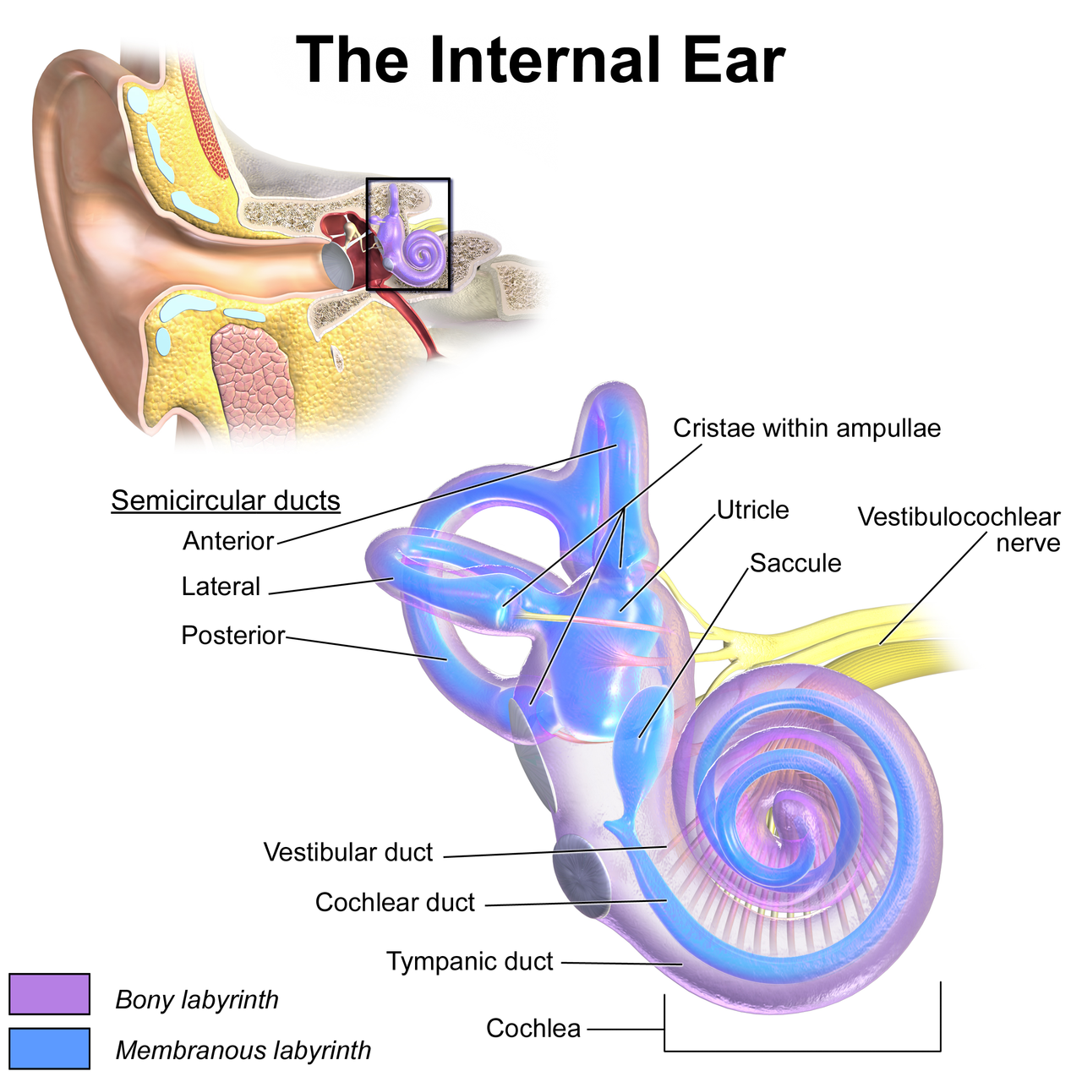
What are we studying?
Hearing loss
damage or dysfunction at any point along the auditory pathway including outer ear to auditory cortex
MRI scans that produce grey matter images
Hearing Thresholds: the lowest intensity at which a person can detect sound at different frequencies.

Slide 4
Causes of Hearing Loss
Aging
Within the inner ear or middle ear
Exposure to loud noise
Genetics, Inheritance
Side effects of some medications

Slide 5
Why are we studying hearing loss?
Look into the correlation of brain size to hearing loss
No treatment or surgery for hearing loss caused by noise
Hair cells do not grow back

Slide 6
Our Project
Predicting Hearing Thresholds from the MRI medical Imaging
By:
Data Mining Techniques.
Deep Learning Models

Slide 7
Data Preprocessing
ID | PT500 | PT4000
smwp1_0001 | 25 | 73
smwp1_0002 | 3 | 10
Original Data (Pre Cleaning)
Excel File
171 Sample
Noisy Data, Negative Values
Two Frequencies (PT500 PT4000)

Slide 8
Data Preprocessing
ID | PT500 | PT4000
smwp1_0001 | 25 | 73
smwp1_0002 | 3 | 10
Cleaning Process
- Negative values have been removed.
- Outliers have been removed regarding to the Z-Scores (Threshold = 3)
- Post Cleaning
- 162 Samples
-1 outlier, and 9 negative values.

Slide 9
Data Preprocessing
Image 1
Shape | (113,137,113)
Data Type | float64
Min Intensity | 0.0
Max Intensity | 0.859
Medical Images
The associated Images to the noisy data have been deleted.
Image Shape:
[113, 137,113]
Preprocessing
Intensity Data range is :[0.0,1.102]
After Normalization
Intensity Data Range is : [0.0,1.0]

Slide 10
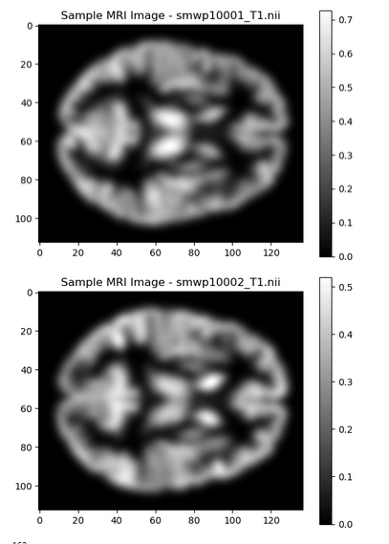
Image Examples
Taken by:
plt.imshow(data[:, :, data.shape[2] // 2], cmap='gray')
Where data is the file containing the images

Slide 11
Splitting the Data
Input Data: Images after Normalized
Output Data: Thresholds, Excel Data (without Noisy)
Training Model Data:80%, Testing Data: 20%
Training Model Data:90%, Validation Data: 10%

Slide 12
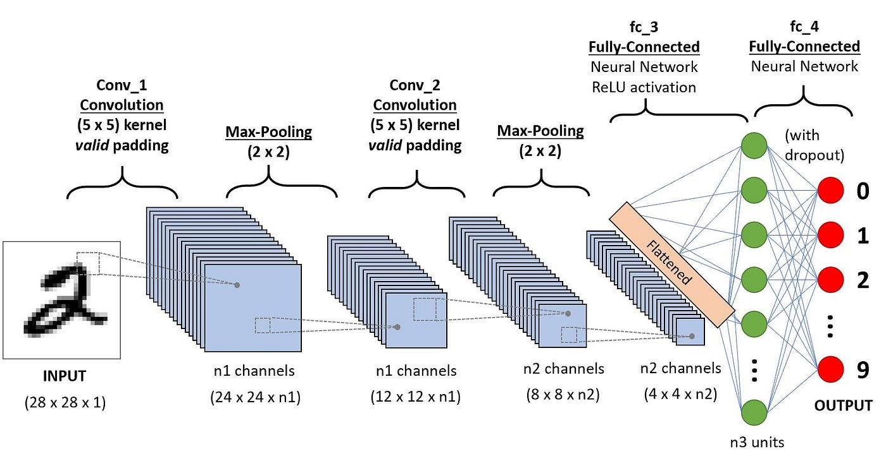
CNN

Slide 13
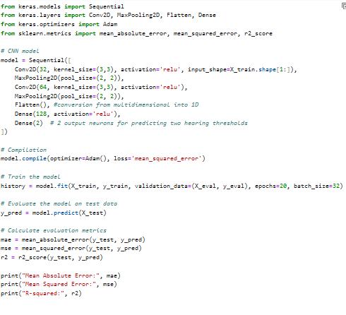

First CNN Model:
Not too bad.
7 layers
Kernel size: 3,3
Activation: Relu
Epochs: 20
Batch Size:32

Slide 14
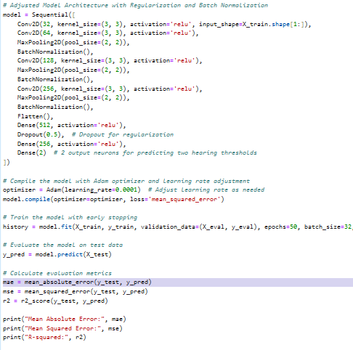

Second CNN Model:
Much Better.
15 layers
Kernel size: 3,3
Activation: Relu
Epochs: 50
Batch Size:32

Slide 15
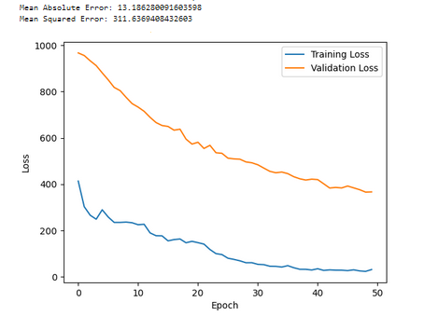

Slide 16
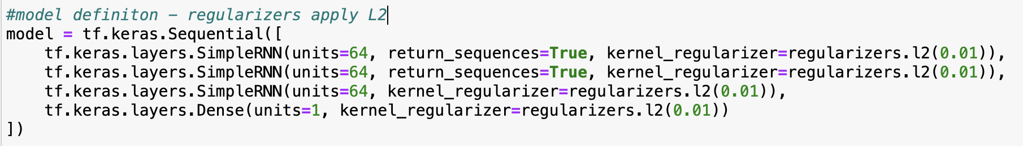
RNN
This model defines a recurrent neural network (RNN) model using TensorFlow and Keras, a high-level deep learning library.
- Three Simple RNN layers and 1 Dense layer
Notes:
This model defines a recurrent neural network (RNN) model using TensorFlow and Keras, a high-level deep learning library.
Why Keras? Keras provides a high-level, user-friendly interface for building and training deep learning models. Doesn’t require low level details such as back propagation and parameter updates and can just specify which optimizer to use, in this case ‘adam’
- Three Simple RNN layers and 1 Dense layer
Each layer is 64 units which specifies the dimensionality of the output space
We specify the return_sequence to be true for the first two layers in order to have it return multiple sequences of outputs rather than one which is helpful when stacking the multiple layers
The last layer does not return a sequence because it generates the output to be processed by the dense layer by its preceding layers (that had a sequence of outputs)
This was important because we want a single output
Used the regularizers library from keras to give L2 regularization
This process helped prevent overfitting
The dense layer at the end is a single unit where the model will produce a single continuous value
This model was picked because RNN is good for prediction

Slide 17
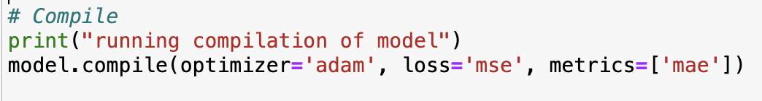
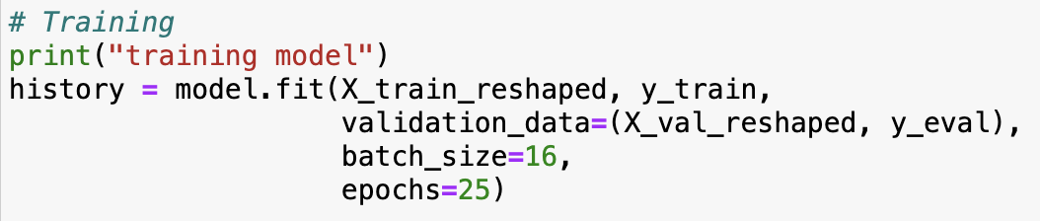
RNN cont.
Notes:
In the compilation of the model we can use the “.compile” method from keras to specificity the optimizer loss function and the evaluation metric(s) we want to use
For this model we used the ‘adam’ optimizer
Used adam for its popularity in being efficient and robust
The loss function we decided to use was ‘mse’ or Mean Squared Error, which would measure the average squared difference between models prediction and the actual target value
Then for the metric we used ‘mae’ or Mean Absolute Error, because this metric would give us insight on the accuracy of the model by taking the average absolute difference between the predictions and target values
The fit method defines the training data to train the model with in our case ‘X_train_reshaped’ and ‘y_train’
The model will iterate over the training dataset multiple times, adjusting its parameters to minimize the specified loss function (mse)
After each iteration the model evaluates the training based on the validation data; in our case ‘X_val_reshaped’ and ‘y_eval’
This step is important because it helps monitor the models performance on data not used for training and can help detect overfitting or adjusting of parameters
Batch size here defines the number of samples to train before updating the model parameters
Epochs defines The number of times the entire training dataset is passed forward and backwards through model training

Slide 18
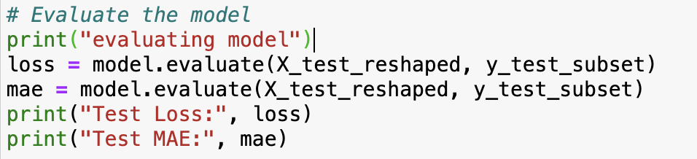
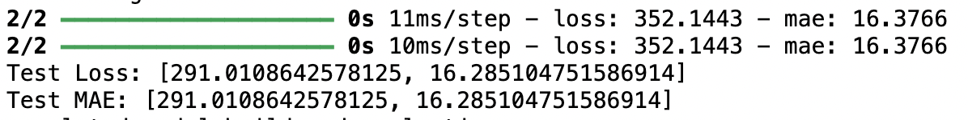
RNN cont.
Notes:
This information is stored in the history object to later be visualized.
The evaluate method computes the loss value and mae metrics on the test data, using the trained model's learned parameters.
The computed loss value represents the model's performance in terms of the mse loss function
The mae gave us insight on the average absolute difference between the model's predictions and the actual target values.
The training loss 407.5799 and mae 15.1679 indicate the average loss and absolute difference between the model's predictions and the actual target values on the training dataset after 25 iterations. With such high numbers this suggests a poor alignment between the prediction and target values.
The Test Loss 291.0109 and Test Mean Absolute Error 16.2851 represent the model's performance on a separate test dataset, which was not used for training or validation.
When we compare the two (test matrix and validation matrix) we can see that while the testing is also high it is consistent with the validation. This does suggests that the model is consistent with unseen data compared to its training data. Next John is going to talk about the LSTM model

Slide 19
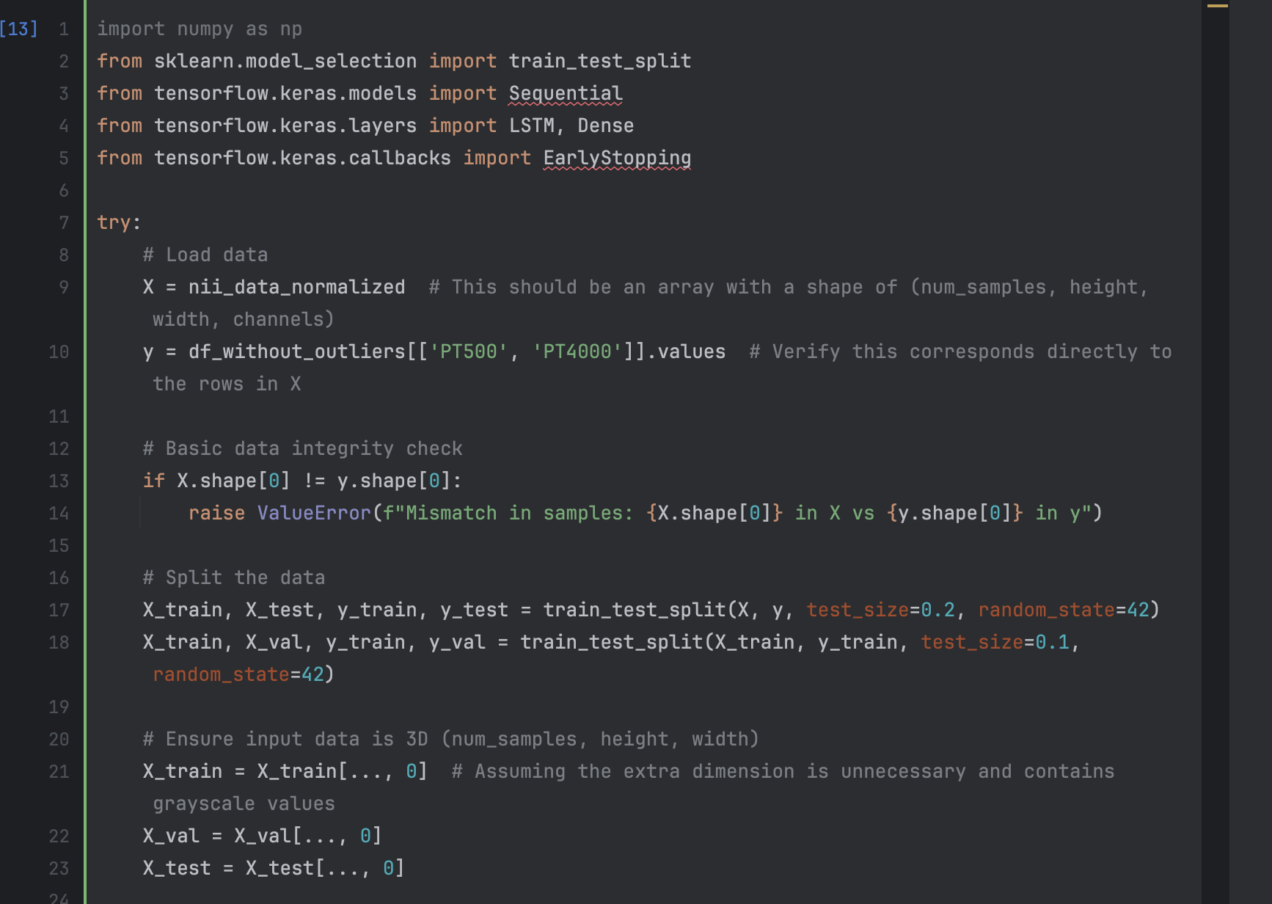
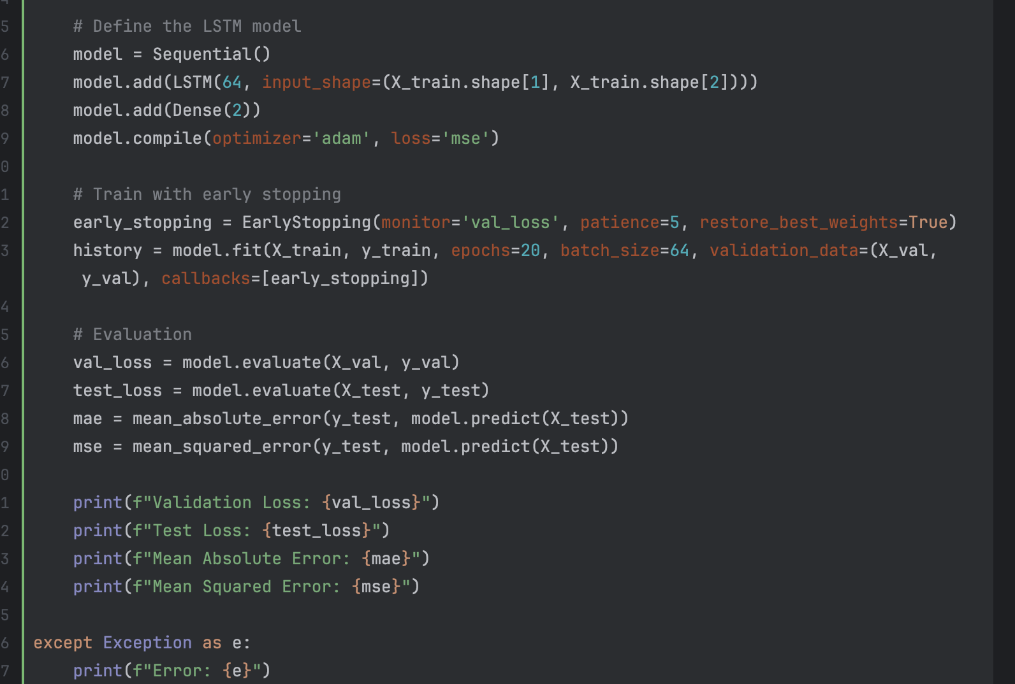
LSTM - Long Short-Term Memory
Model similar to RNN
Uses TensorFlow and Keras
Framework known for being simple to use
Ability to stack layers
Great for Time-Related Data
Combats vanishing gradient problem

Slide 20
LSTM cont.
One Simple LSTM layer and 1 Dense layer
Early Stopping
History
Evaluation
Validation Loss
Test Loss
MAE
MSE
Best measures for accuracy

Slide 21
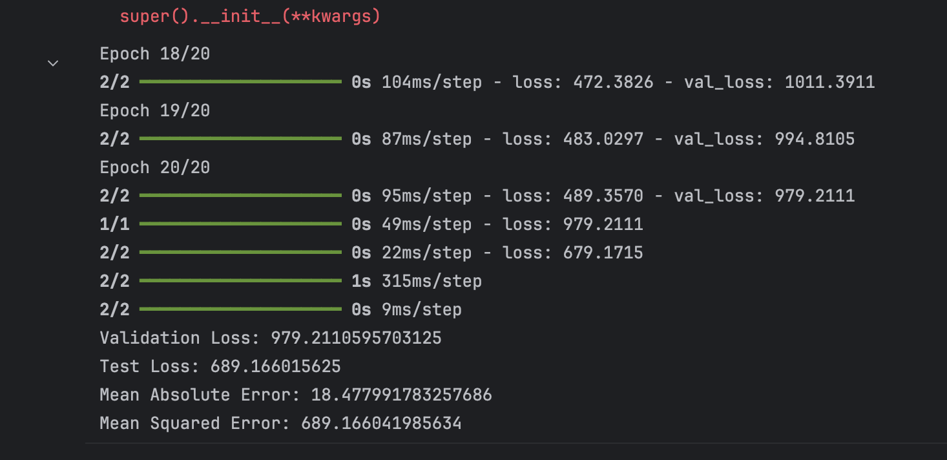
LSTM cont.
20 epochs
Validation vs. Test Loss
Mean Calculations
Average difference between the model's predictions and the actual target values.
Absolute vs Squared Differences
Significantly larger
Ways to decrease loss?
More Model Layers
Increase Epochs
Increase Batch Sizes

Slide 22
Conclusion
Different Layer Structure
More = Better
Epoch matter, but not too much
- CNNs are well-suited for capturing spatial patterns; like images
- Simple RNNs and LSTMs excel at capturing temporal dependencies over time
- our results mimic this
Notes:
Some difficulties in getting the loss low for simple RNN and LSTM. This could be due to the fact that RNNs and LSTMs are better at capturing data that affects the next set of data where as a CNN is very good at capturing and identifying patterns in images
Because of this based on research and our results we can conclude that the CNN model worked best then the simple RNN and lastly the LSTM model performed the worst.

